Slide 1
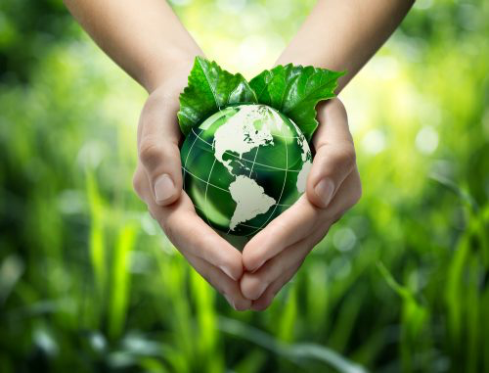
A Sustainable Planet
Week 1
Introduction
Dr Vicky Coker & Prof Sophie Nixon
Department of Earth and Environmental Sciences
Sophie.nixon@manchester.ac.uk; Manchester Institute of Biotechnology (MIB)
vicky.coker@manchester.ac.uk; G.15, Williamson Building

Slide 2


Your team…..
Prof Sophie Nixon
Chair in Environmental Microbiology and Biotechnology
sophie.nixon@manchester.ac.uk; 2.027, John Garside Building (MIB)
Research interests in:
Microbiology of extreme environments
Microbial carbon cycling
Nature-Based Solutions / Environmental Biotechnology
Dr Vicky Coker
Lecturer in Environmental Mineralogy
vicky.coker@manchester.ac.uk; G.15, Williamson Building
Research interests in:
Microbe-metal interactions
Soil contaminant/pollutant mobility
Critical metal extraction using bioprocesses

Slide 3
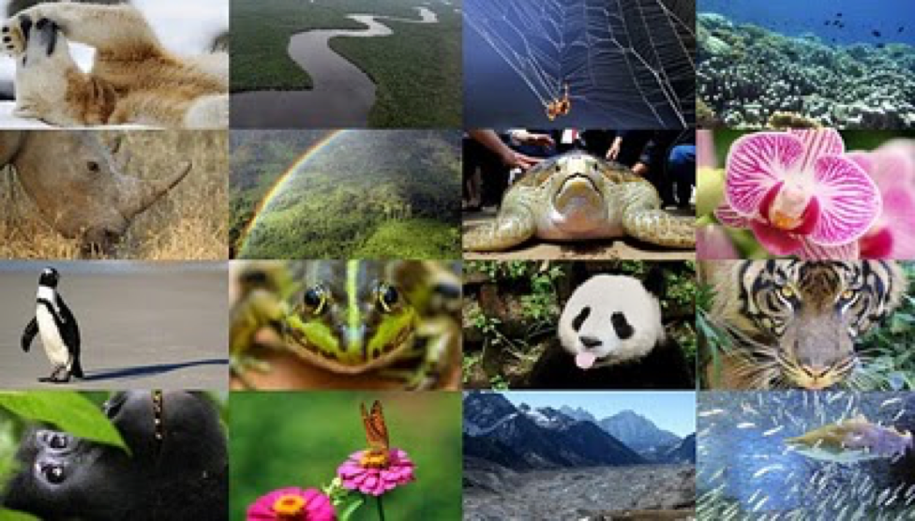
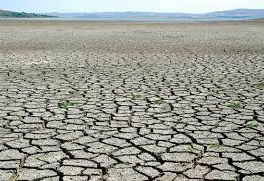

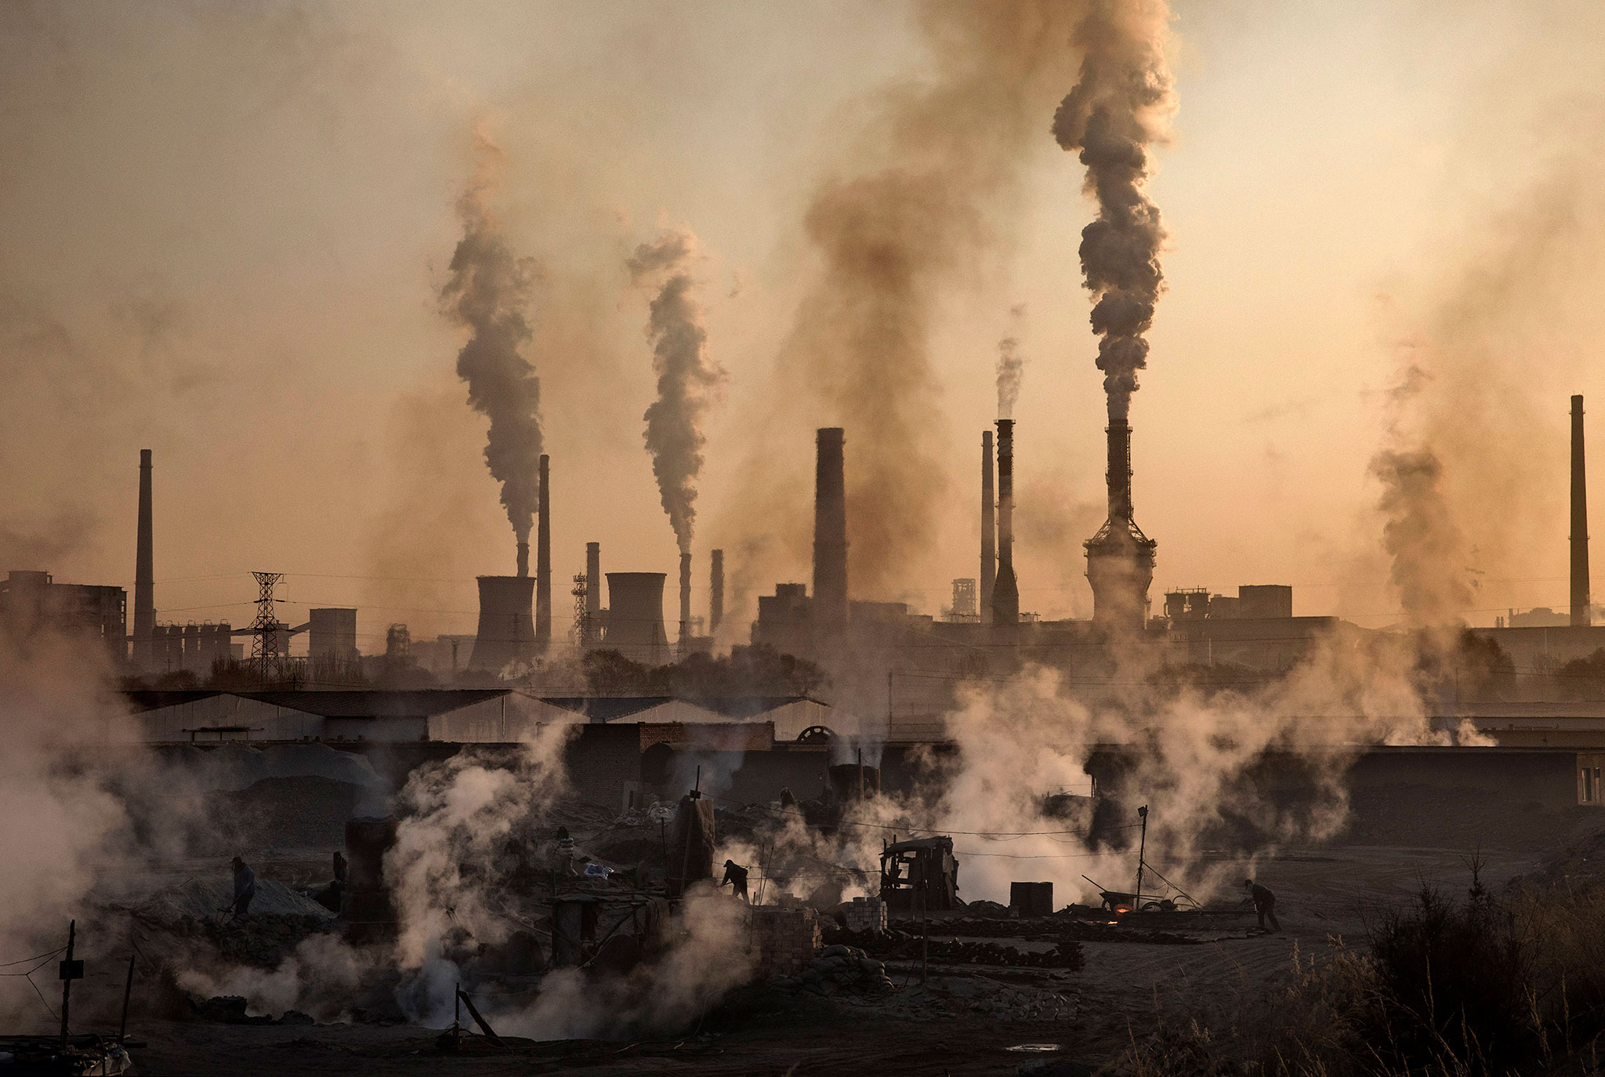
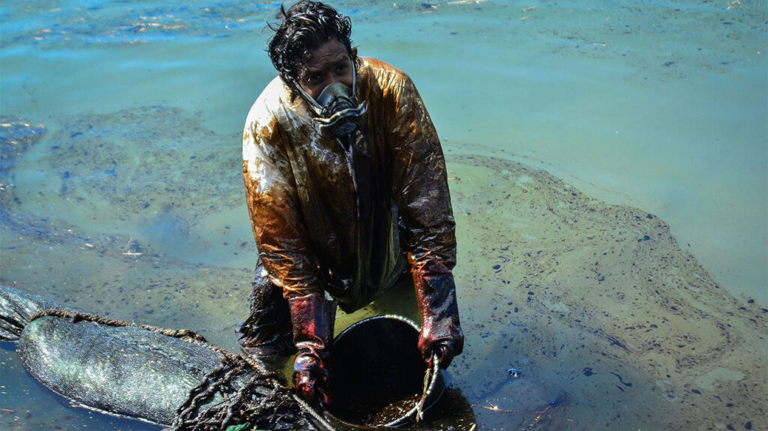
Which large-scale environmental issues concern you most?

Slide 4
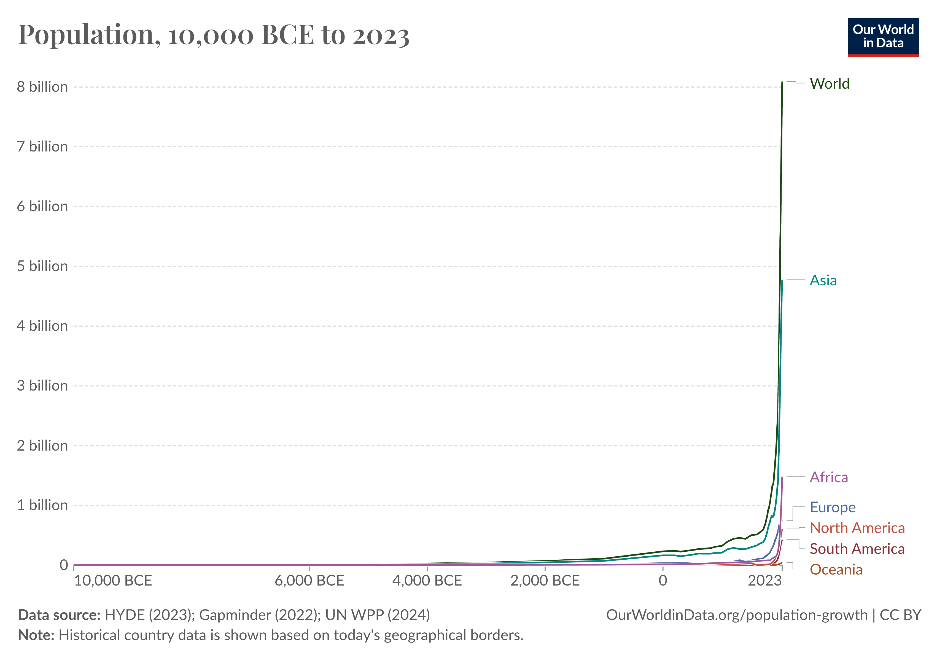
Population growth underpins many environmental issues
As of January 27, 2025, the global population is approximately 8.2 billion people

Slide 5

We need global coordination to address multiple problems
https://www.un.org/en/about-us

Slide 6

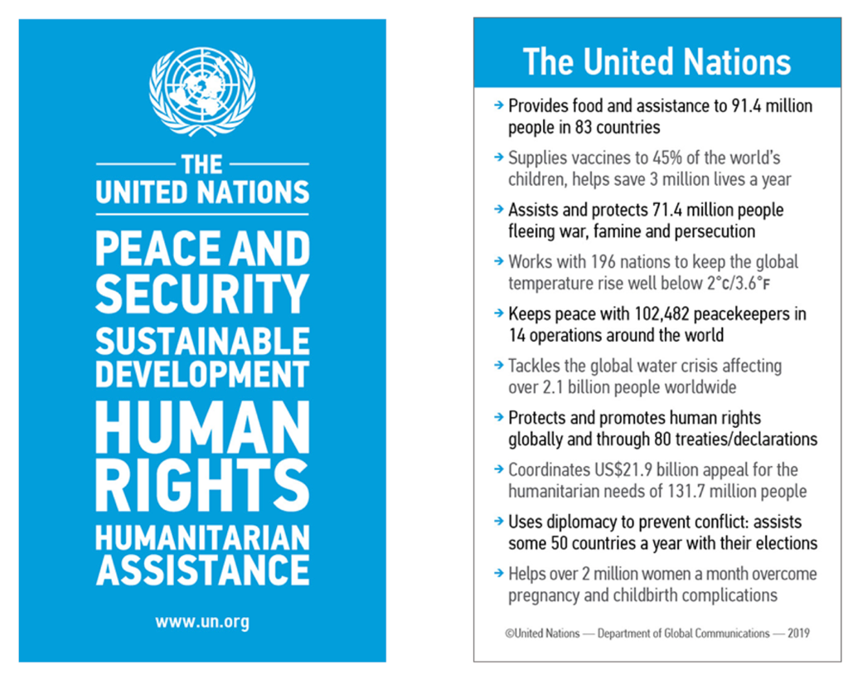
Founded in 1945 and now has 196 member states
UN Chief António Guterres

Slide 7
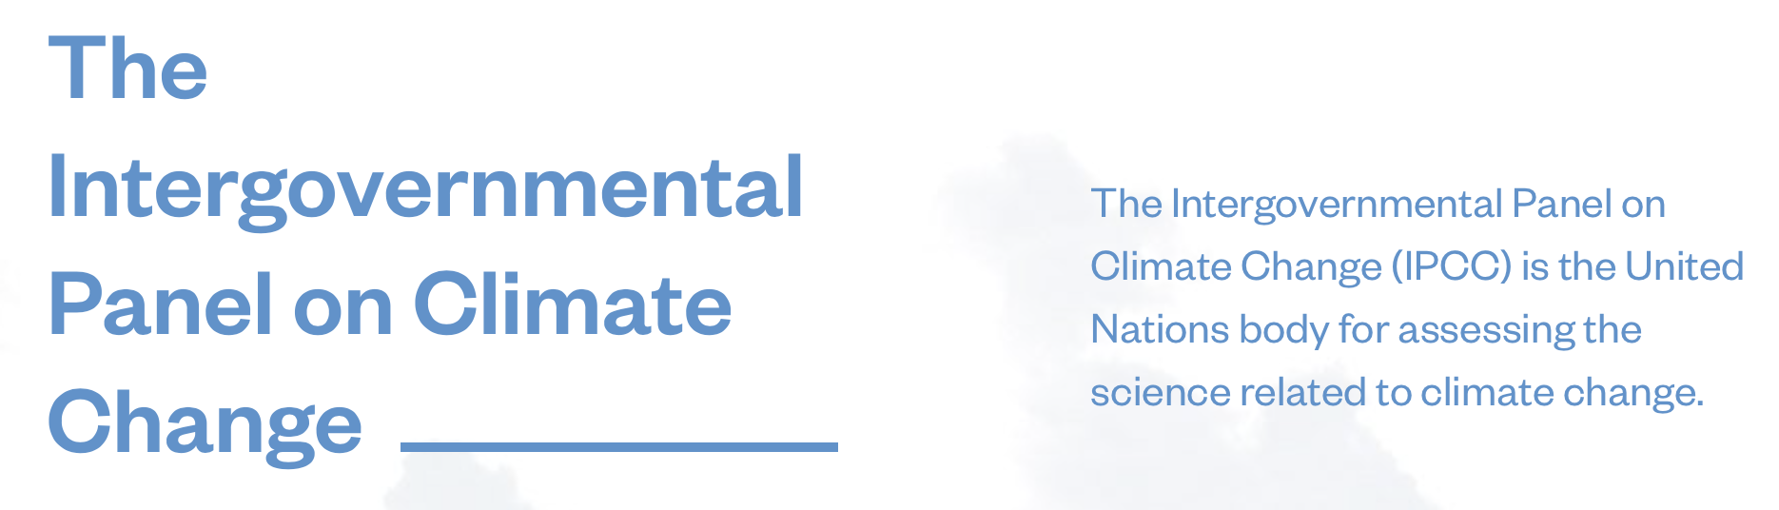
Analysing data on climate change
In the last five years, there were ~18000 peer reviewed research articles with titles that included the phrase “climate change”!

Slide 9
The UN Sustainable Development Goals
The Sustainable Development Goals are the blueprint to achieve a better and more sustainable future for all.
They address global challenges, including those related to poverty, inequality, climate, environmental degradation, prosperity, and peace and justice.

Slide 10
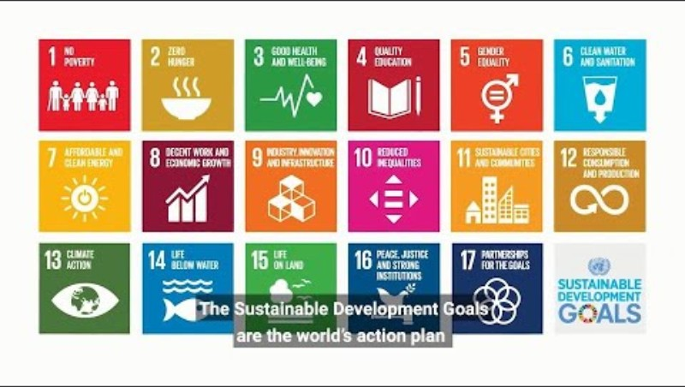
A decade of action

Slide 11
Resolving these challenges requires:
Knowledge of basic, underpinning processes – the sorts of things achieved through "blue-skies" research
Knowledge of impacts of individual and multiple perturbations in different socio-ecological contexts – transdisciplinary!
Knowledge of best practices and technologies to achieve long lasting sustainable solutions

Slide 12
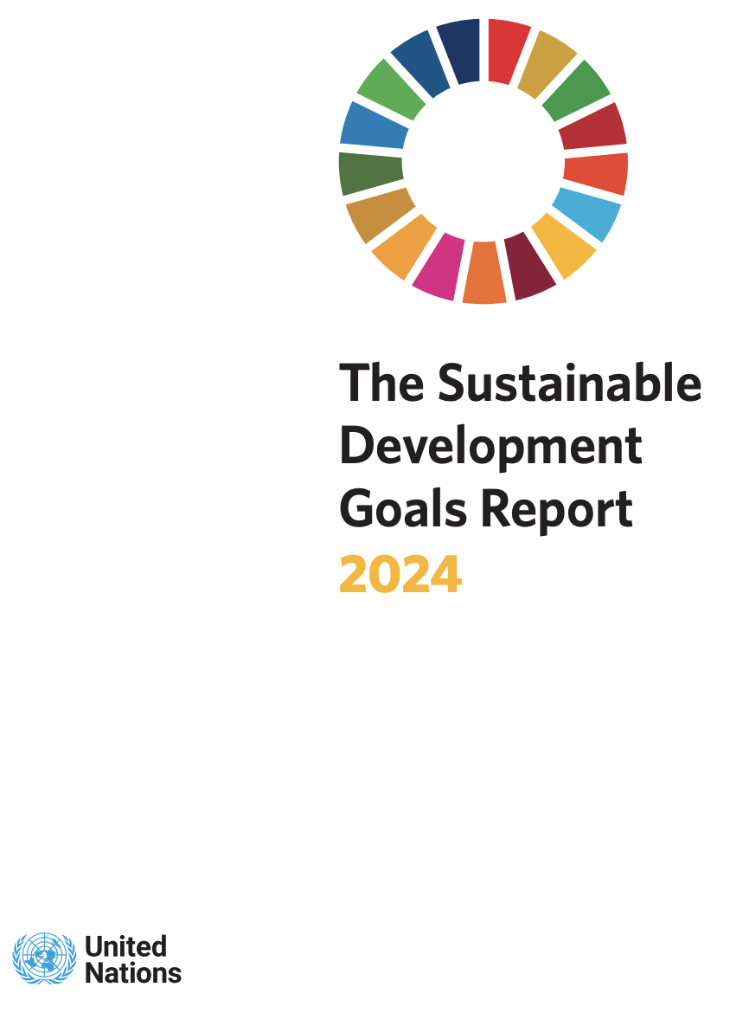
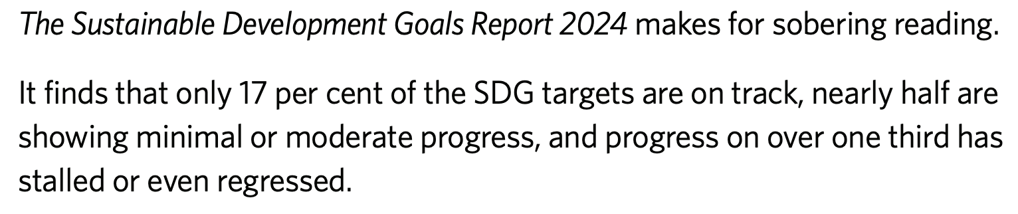
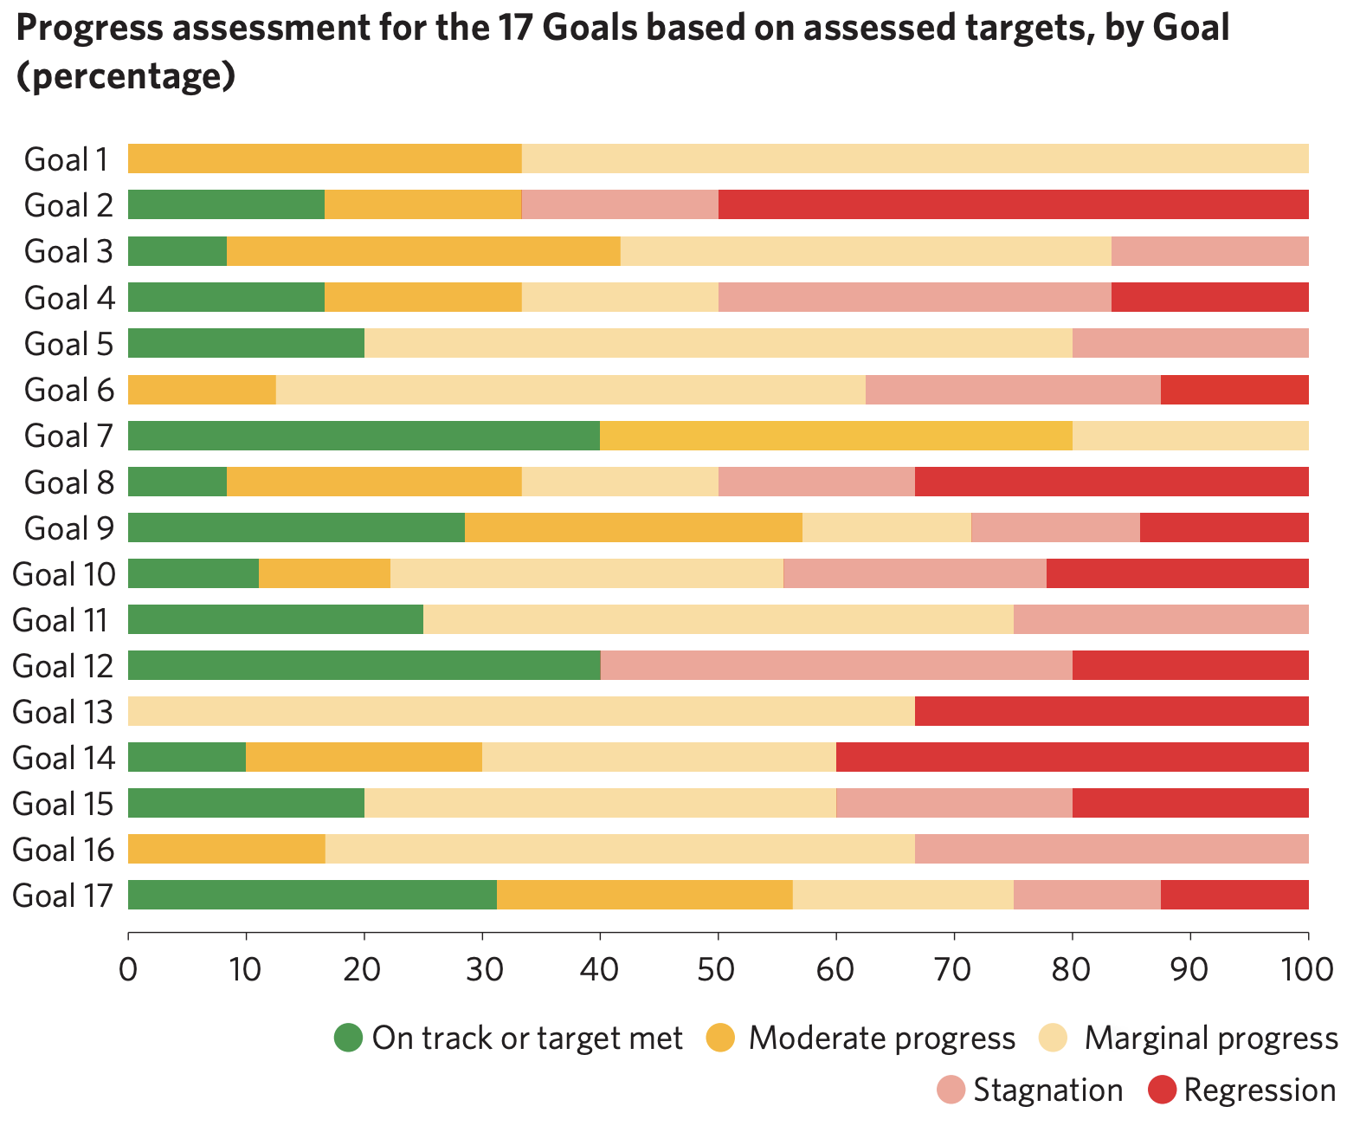
How are we doing?
•
NO POVERTY
•
ZERO HUNGER
•
GOOD HEALTH & WELL-BEING
•
QUALITY EDUCATION
•
GENDER EQUALITY
•
CLEAN WATER & SANITATION
•
AFFORDABLE & CLEAN ENERGY
•
DECENT WORK & ECONOMIC GROWTH
•
INDUSTRY, INNOVATION & INFRASTR.
•
REDUCED INEQUALITIES
•
SUSTAINABLE CITIES & COMMUNITIES
•
RESPONSIBLE CONSUMPTION & PROD.
•
CLIMATE ACTION
•
LIFE BELOW WATER
•
LIFE ON LAND
•
PEACE, JUSTICE, STRONG INSTITUT.
•
PARTNERSHIPS FOR THE GOALS

Slide 13
Addressing these goals needs talent, skills, enthusiasm and wisdom from the next generation of achievers
Our aim for this course and degree programme is to equip YOU to address these goals

Slide 14

Overall aims of “A Sustainable Planet”
Provide an overview of key global sustainable development challenges related to environmental science
Highlight examples (often in peer-reviewed journals) illustrating the scale, breadth, complexity and uncertainty surrounding these key challenges
Show how sustainable development issues relate to both developed and less-developed nations
Provide insight into promising solutions to tackle global sustainable development issues
Provide some key fundamental knowledge of concepts and mechanism underpinning global challenges

Slide 15



Aims for today
Provide an overview of the structure of the course
Introduce you to the United Nation’s ‘Sustainable Development Goals’
Highlight how your skills and interests and degree programme are relevant to solving society’s ‘grand challenges’ and tackling sustainable development goals

Slide 16
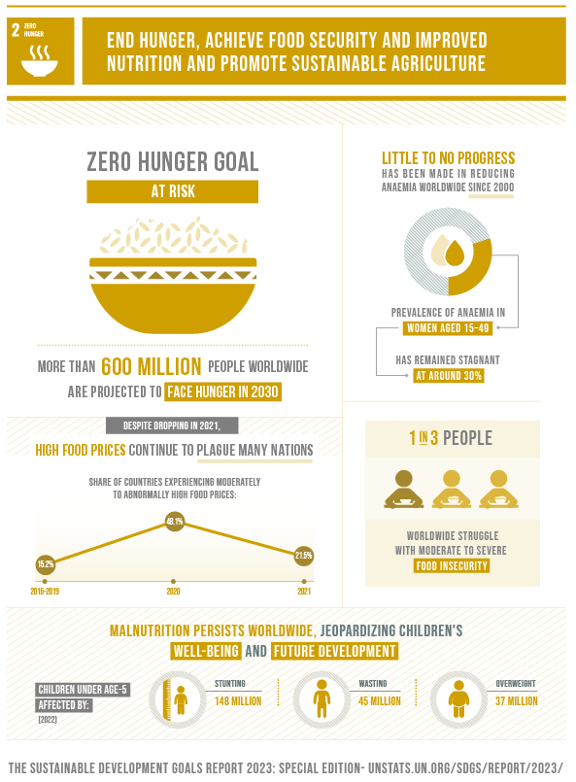
Key environmental science related challenges:
More food needed, using fewer resources
Reduce environmental impact of growing and distributing this food
Identify new ways to grow food, extract plant-growth limiting resources
Ensure farming systems are resilient to perturbations and pests
2024 status: Regression

Slide 17

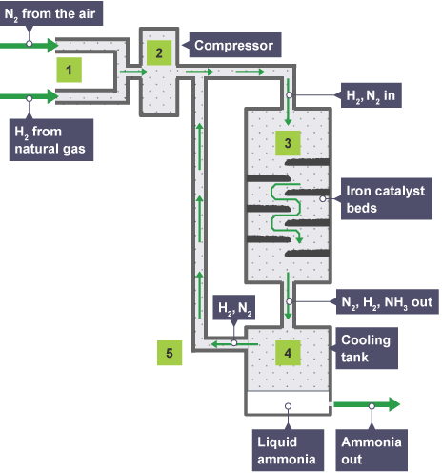
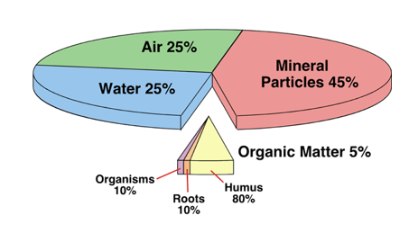
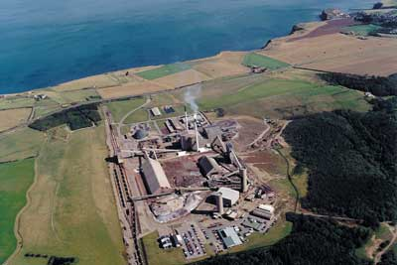

Soils and fertilizers as resources
Haber-Bosch Process
Boulby potash mine, UK
Apatite-Ca₅(PO₄)₃(F,Cl,OH)₂

Slide 18
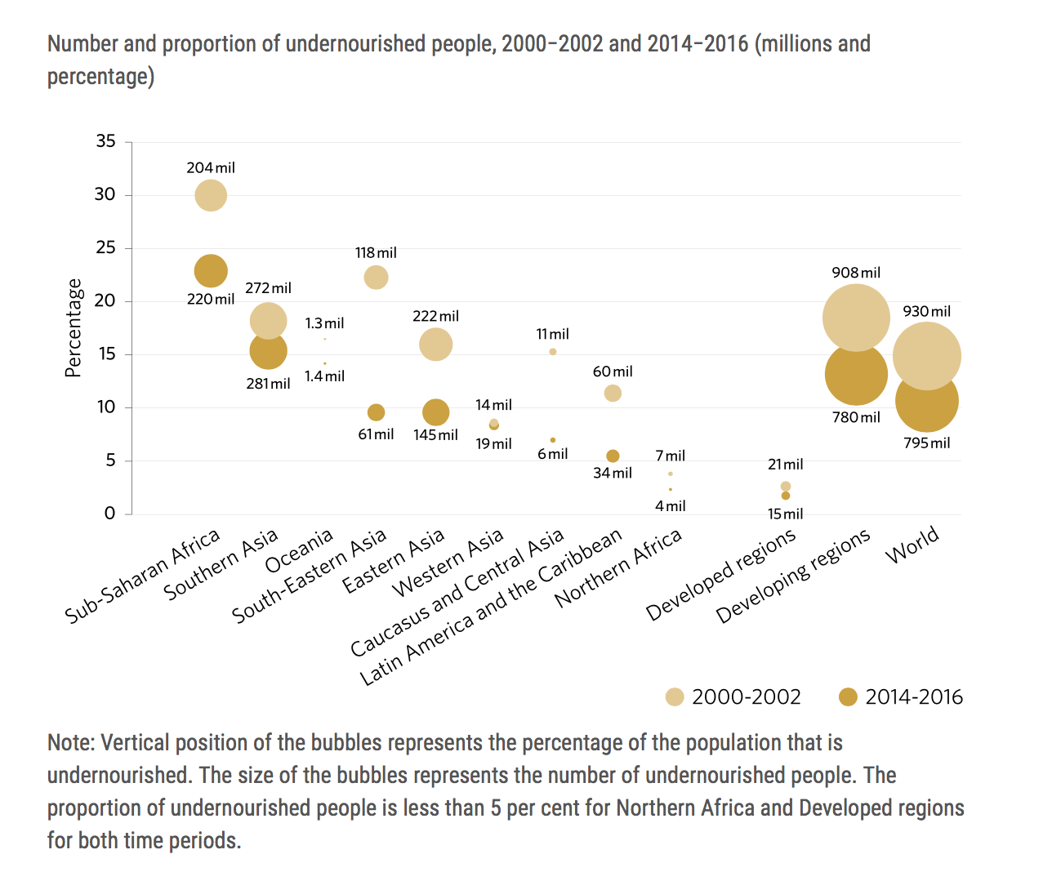
https://unstats.un.org/sdgs/report/2016/goal-02/

Slide 19
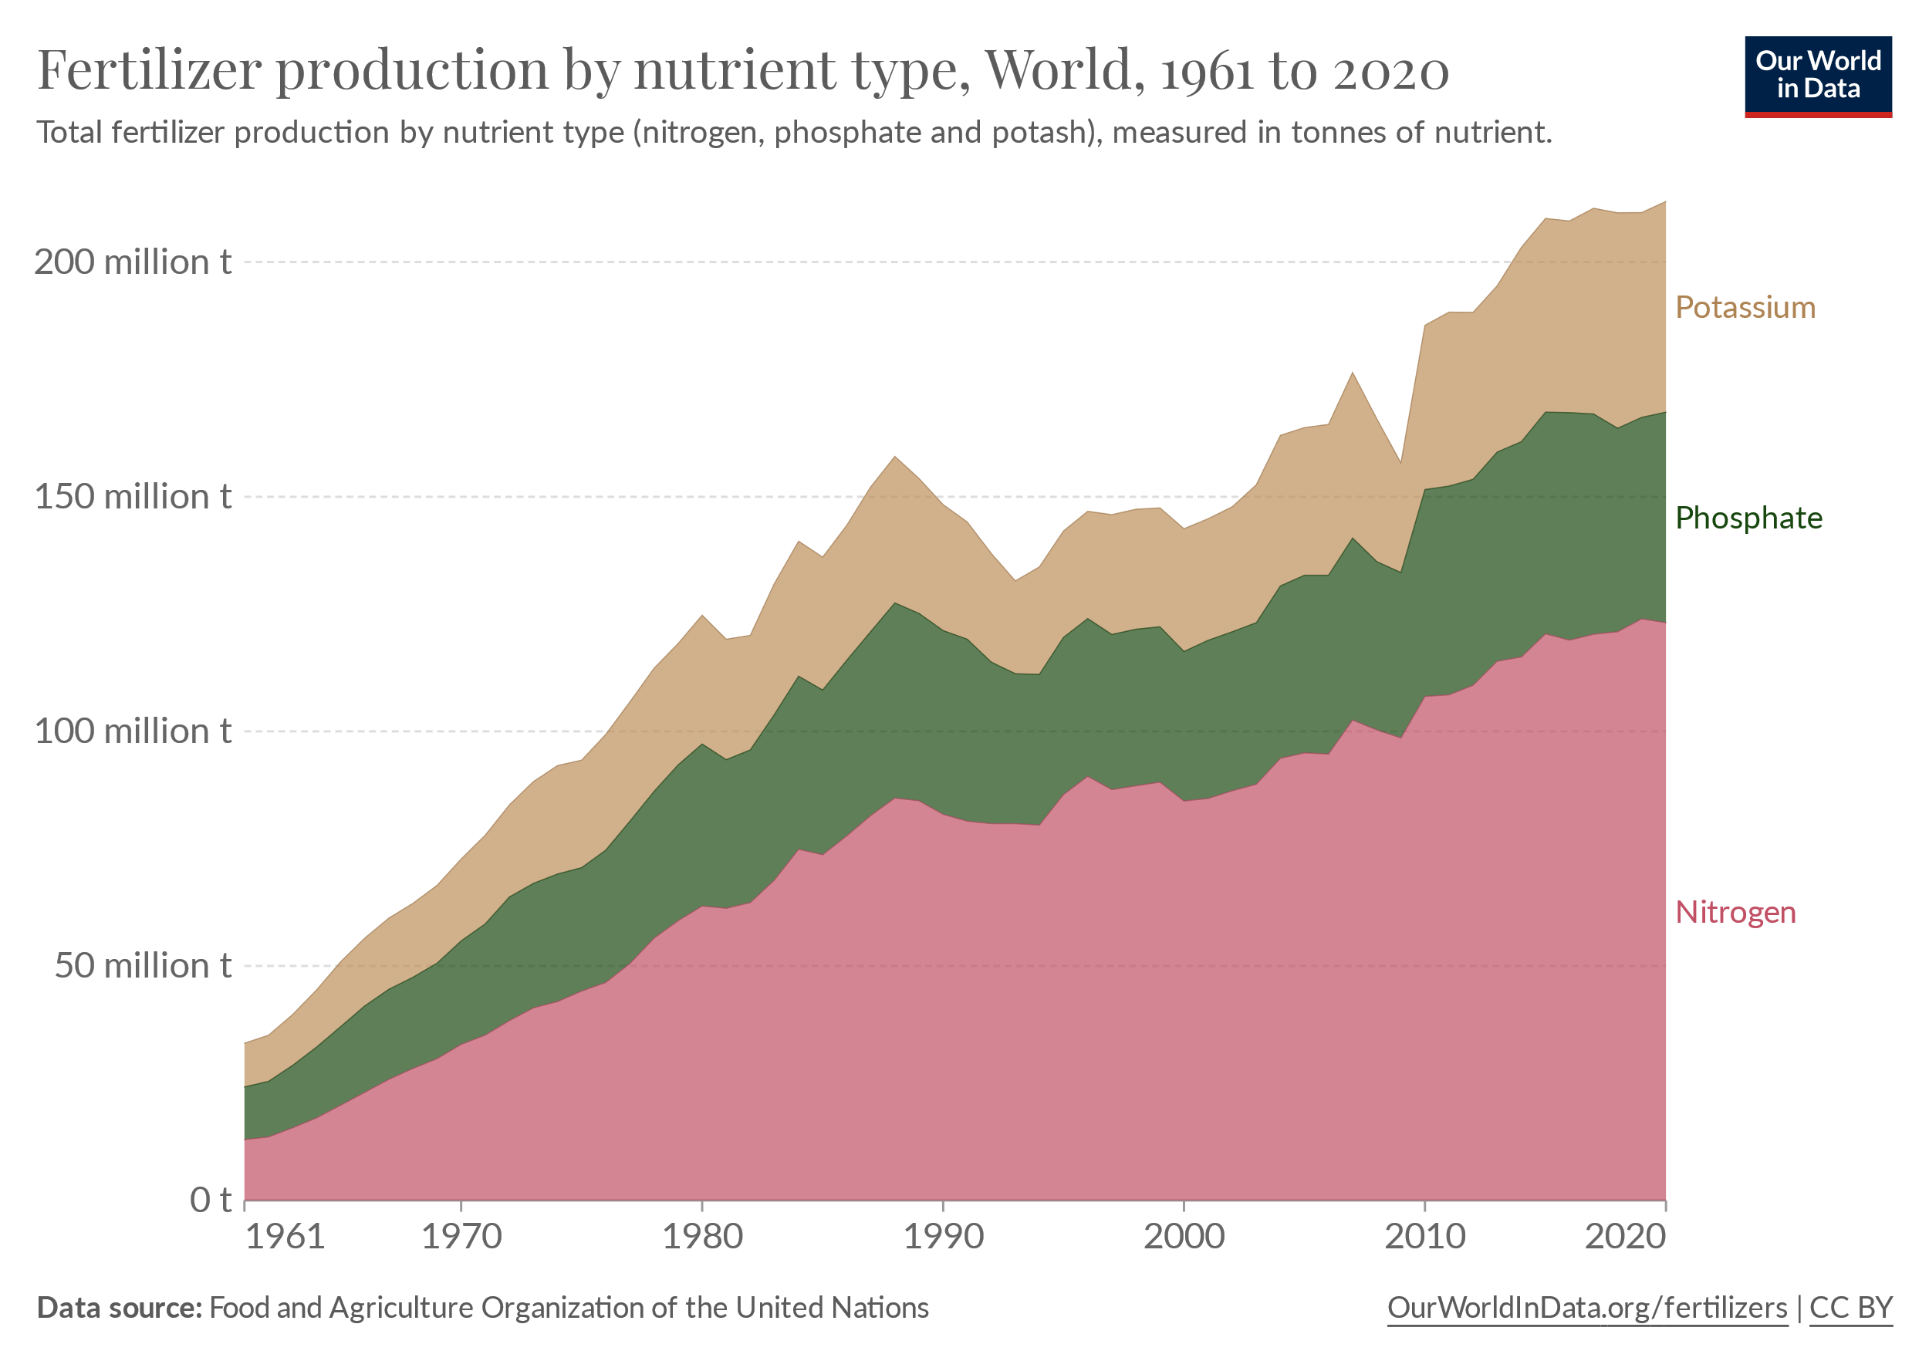
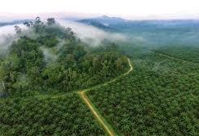
Producing food is linked to extracting and making resources
Palm oil: this controversial crop is a mainstay of much processed food. In many plantations, 800-1000 kg of N are applied per hectare (compare to about 200kg N ha⁻¹ for wheat in the UK)
Global production of nitrogen, phosphorus and potassium fertilisers in the last 60 years

Slide 20
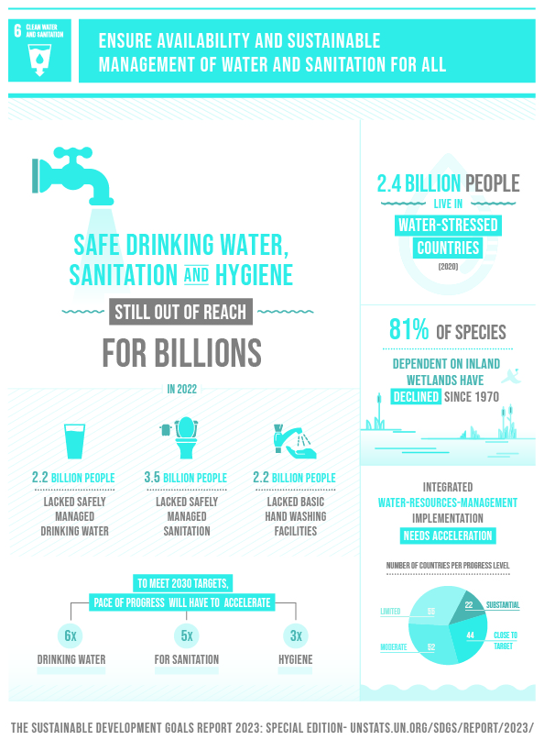
Key environmental science related challenges:
More potable water needed
Reduce wastage of water
Ensure clean water is not contaminated
Grow crops that have less dependency on external water supplies
Ensure households have sewage systems
2024 status: Moderate progress

Slide 21

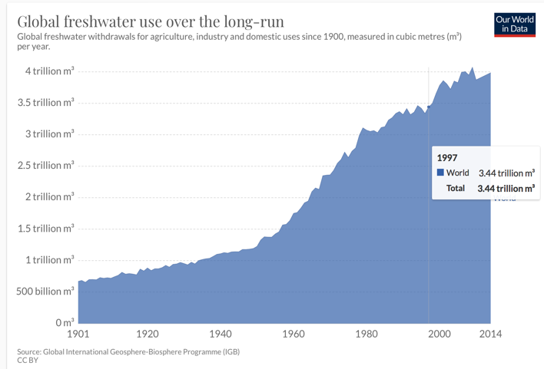
More people = more demand for water

Slide 22

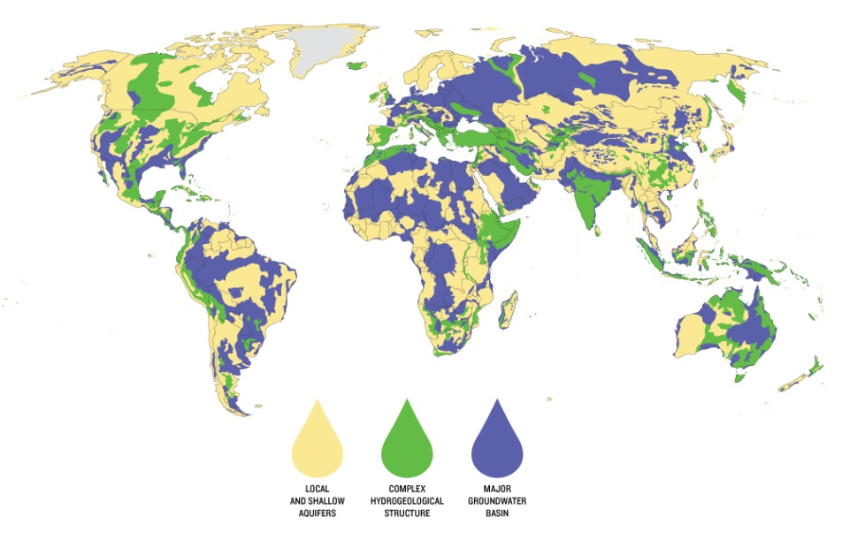

Total volume of water on Earth (100%) = 1,386,000,000 km³
0.65% available freshwater (70% of freshwater is trapped in ice)
Groundwater is our largest reservoir but most big aquifers are below arid regions and therefore do not recharge quickly
Is water a non-renewable resource?
Global trade in virtual water 1000 km³/year = 20 x Nile annual discharge

Slide 23
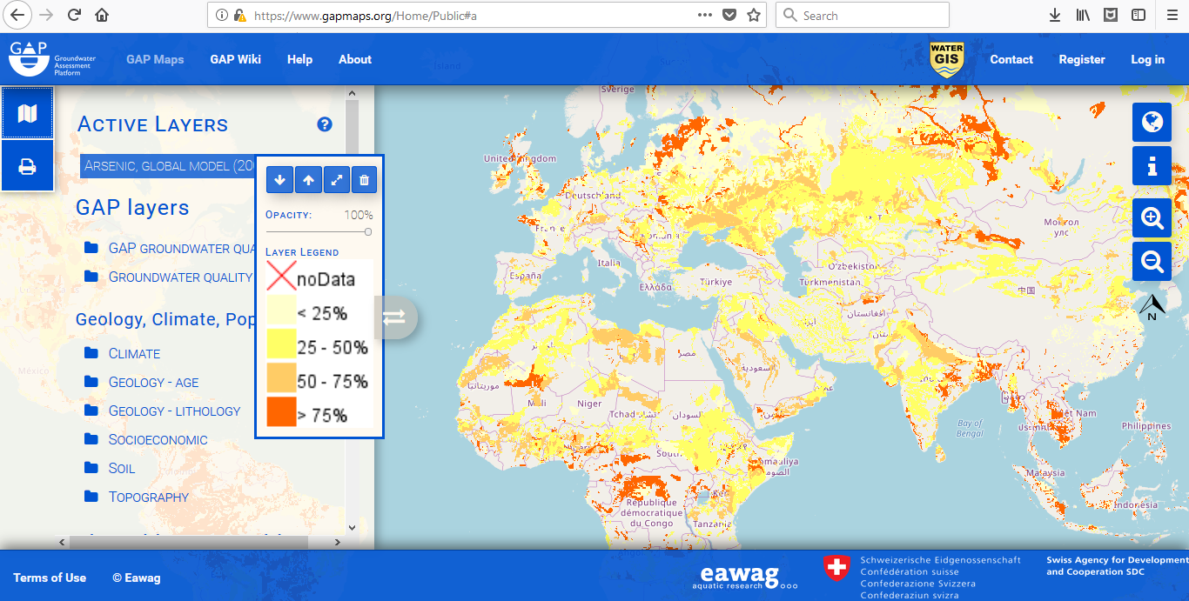
Arsenic in drinking water
3 in 10 people globally lack access to safely managed drinking water services
Water quality, including arsenic, is central to UN Sustainable Development Goals ¹
Major challenges remain in meeting SDGs; NO country on target to achieve all ²
Indicative probability of geogenic groundwater arsenic contamination (www.gapmaps.org, based on data from ³)
Millions of people in S/SE Asia are exposed to dangerous concentrations of arsenic in groundwater; it is “the largest poisoning of a population in history”⁴
¹https://sustainabledevelopment.un.org/sdgs;²http://www.sdgindex.org/reports/2018/;³Amini et al EST 2008; 4 Smith et al Bull WHO, 2000
Slide credit: Dr. Laura Richards

Slide 24
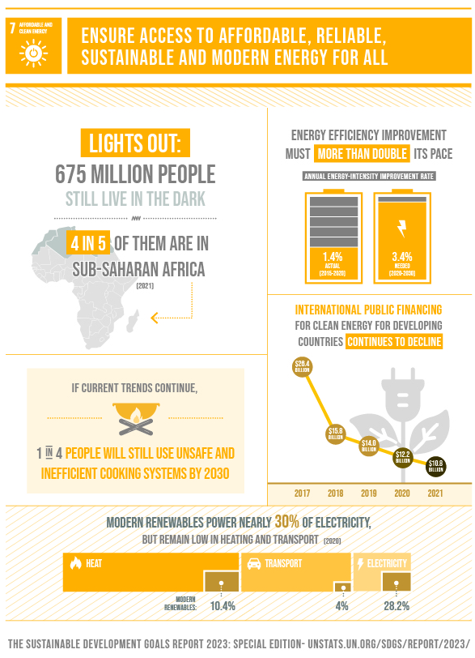
Key environmental science related challenges:
Less dependence on non-renewable sources
Ensure renewable sources genuinely are renewable
Better distribution of energy resources
2024 status: Moderate progress

Slide 25

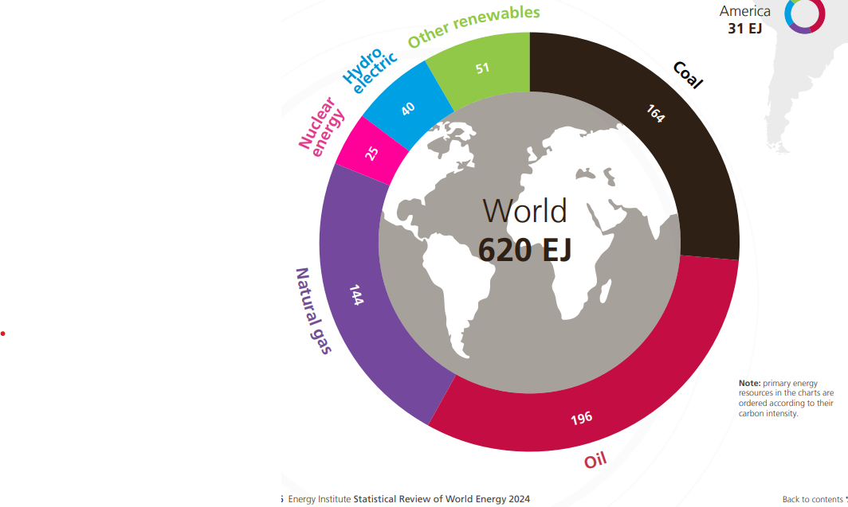
Total primary energy consumption increased by 2% over its 2022 level, 0.6% above its ten-year average and over 5% above its 2019 pre-COVID level.
Renewables’ share of total primary energy consumption reached 14.6%, an increase of 0.4% over the previous year. Together with nuclear, they represented over 18% of total primary energy consumption.
Fossil fuel consumption as a percentage of primary energy dropped 0.4% to 81.5%.
https://www.energyinst.org/statistical-review/home
Notes:
Exajoule 10^18

Slide 26
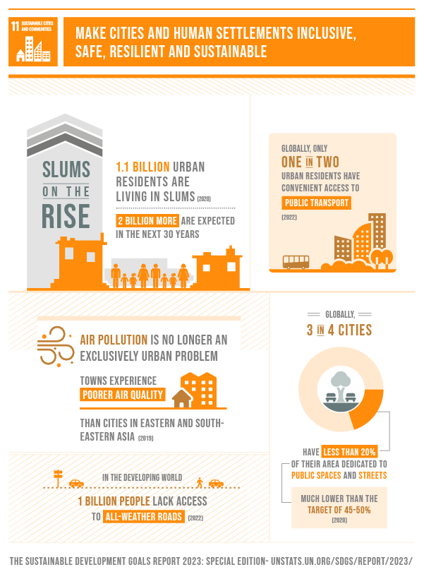
Key environmental science related challenges:
Ensure cities have clean environments (air, water, greenspace, noise)
Ensure clean water is available
Can cities become carbon neutral?
Urban-agriculture?
Conservation of green-belts, use of ‘brown-field’ sites

Slide 27

Sustainable cities – key facts
Half of humanity – 3.5 billion people – lives in cities today and 5 billion people are projected to live in cities by 2030.
95% of urban expansion in the next decades will take place in developing world
883 million people live in slums today and most them are found in Eastern and South-Eastern Asia.
The world’s cities occupy just 3% of the Earth’s land, but account for 60-80% of energy consumption and 75% of carbon emissions.
90% of urban dwellers breathe unsafe air, resulting in 4.2 million deaths due to ambient air pollution. >50% of the global urban population were exposed to air pollution >2.5 times higher than the safety standard (data from 2016).

Slide 28

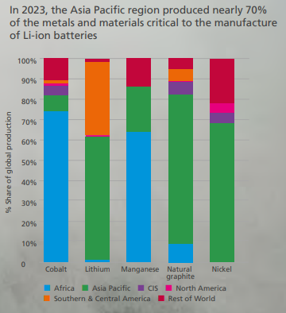
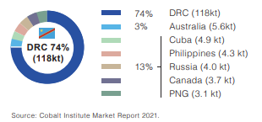
Electrification of vehicles would potentially lead to a reduction in air pollution in cities but what resources are required?
Statistical Review of World Energy 2024
Notes:
Graphite
Lithium
Cobalt
Nickel

Slide 29
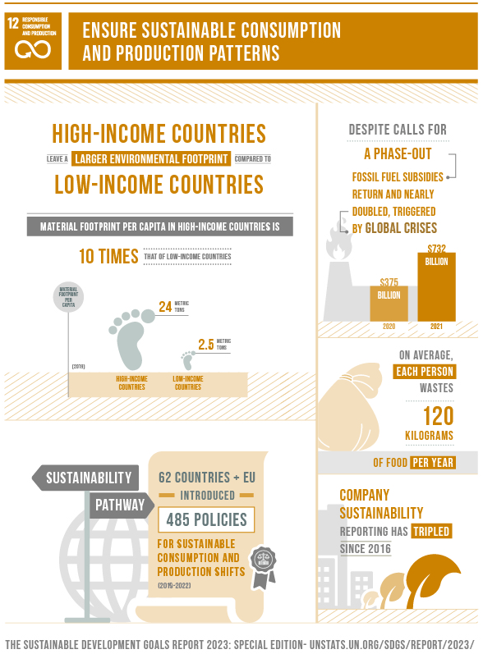
Key environmental science related challenges:
Finding smart ways of using existing resources
For food: remember the soil!
Reduce wastage
Recycle and re-use
Ensure strong policy incentives to promote sustainable consumption
New materials?
2024 status: Stagnation

Slide 30
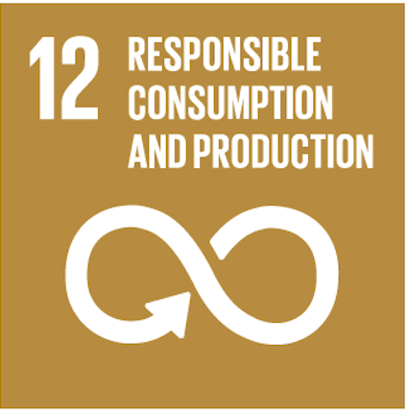
Sustainable consumption – key facts
Each year, 1/3 of all food produced – equivalent to 1.3 billion tons worth around $1 trillion – ends up rotting in the bins of consumers and retailers, or spoiling due to poor transportation and harvesting practices
2 billion people globally are overweight or obese.
Land degradation, declining soil fertility, unsustainable water use, and marine environment degradation are lessening the ability of the natural resource base to supply food.
The food sector accounts for around 30% of the world’s total energy consumption and accounts for around 22% of total greenhouse gas emissions.

Slide 31
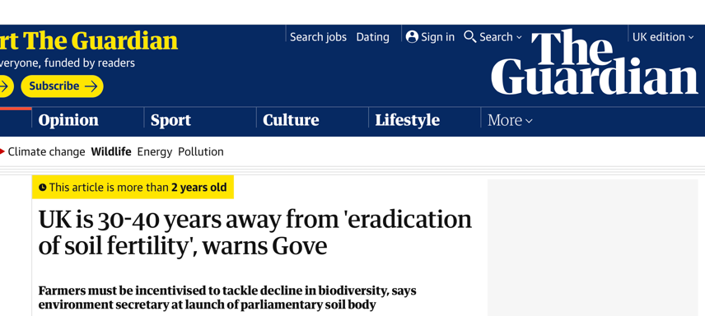
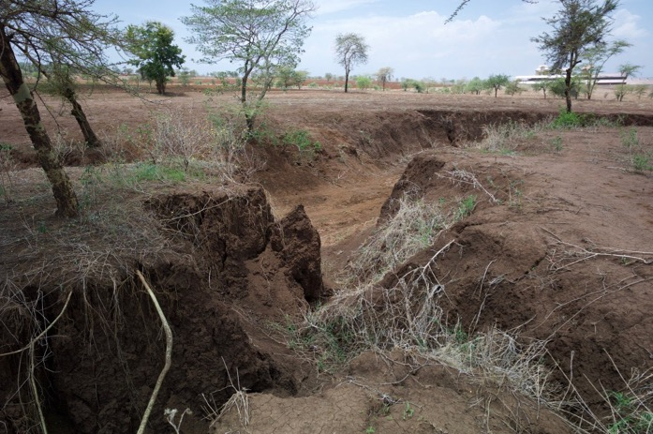
Soils are key to civilisations and production. We degrade them at our peril!

Slide 32
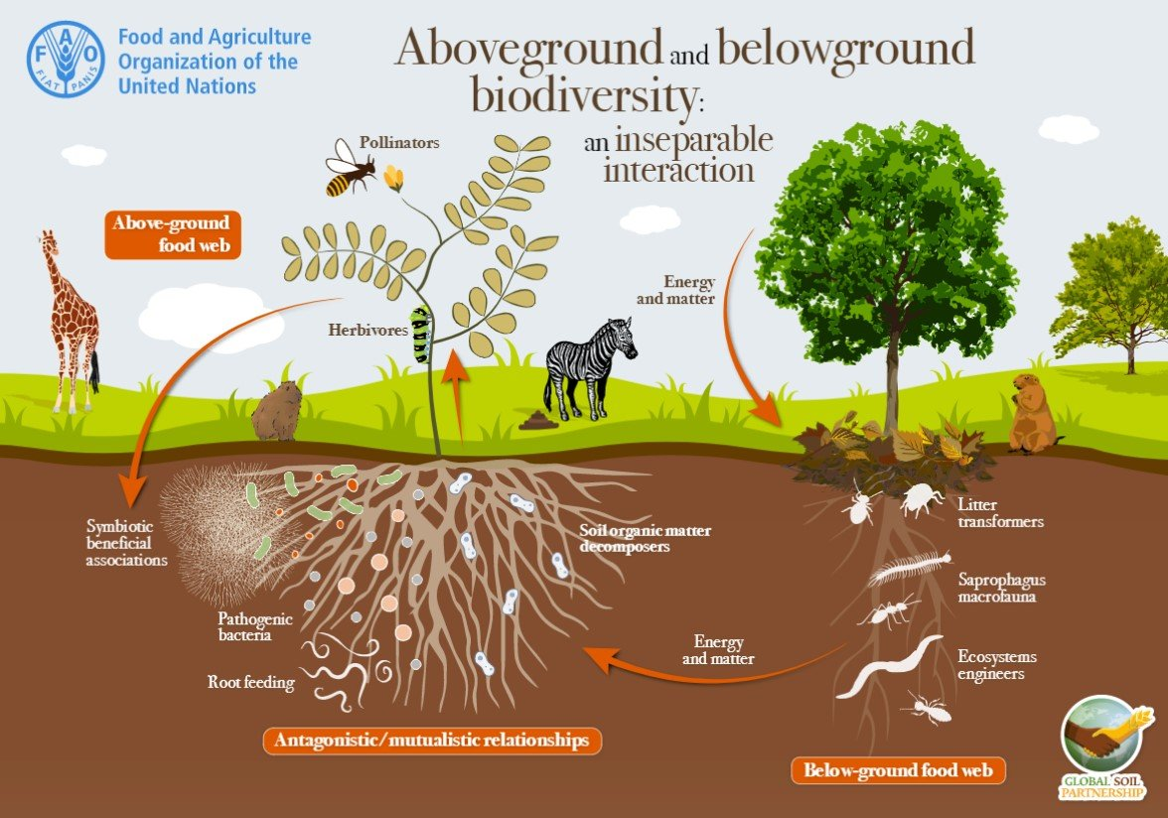
How do soils function?

Slide 33
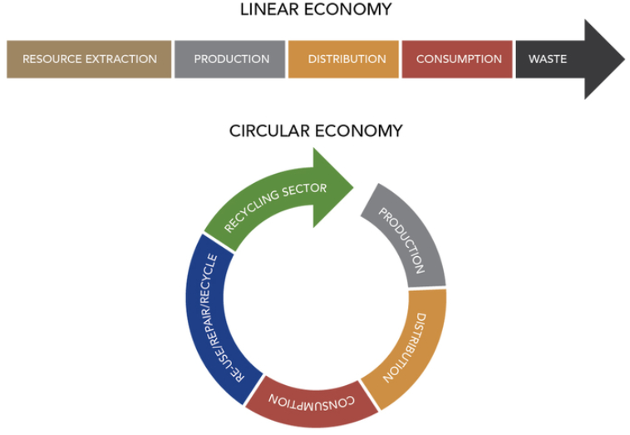
Reduce the carbon and water footprint of resources through recycling of resources
Reduce amount of waste generated that goes to landfill
Should we be mining landfill for critical resources?

Slide 34
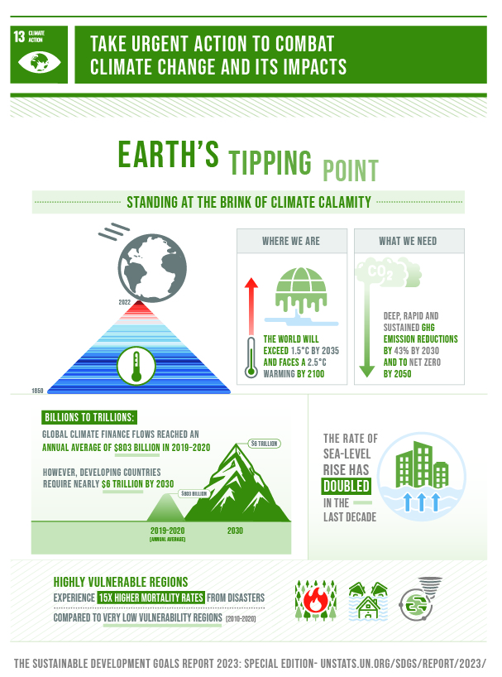
Key environmental science related challenges:
Shift away from GHG-emitting processes, especially energy
Remember the soil!
New technologies: small changes in e.g. battery efficiency can make a big difference
Multifactorial impacts still need to be quantified
Nature-based solutions
2024 status: Marginal progress

Slide 35
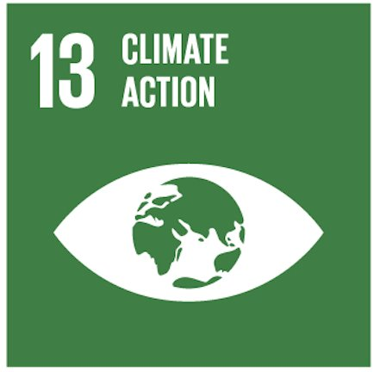
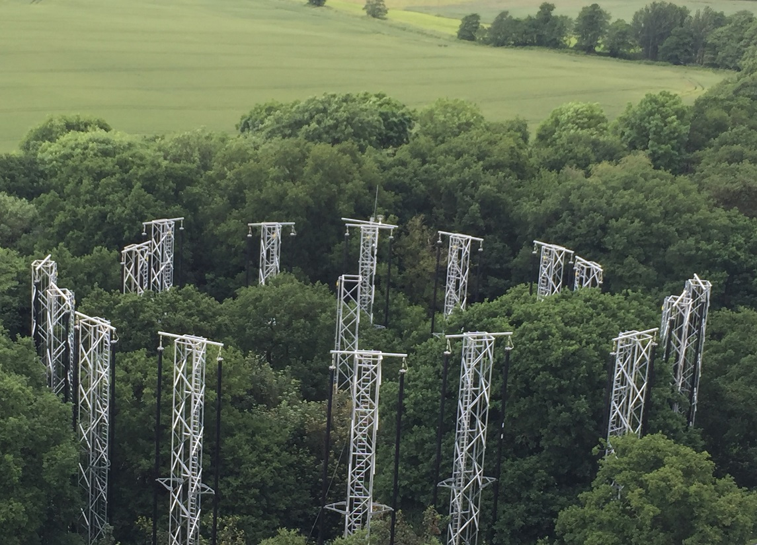
Climate action – key facts
From 1880 to 2012, average global temperature increased by 0.85°C. For each 1 degree of temperature increase, grain yields decline by about 5 per cent.
By the end of this century, the increase in global temperature will exceed 1.5°C compared to 1850-1900.
Global emissions of carbon dioxide (CO₂) have increased by almost 50% since 1990
Emissions grew more quickly between 2000 and 2010 than in each of the three previous decades
Big challenges need big experiments
The Birmingham Institute for Forest Research Free Air Carbon Dioxide Enrichment experiment (BiFOR FACE)

Slide 36
Greenhouse gas emissions are linked to climate change; what are the sources?
These are data for the UK: data are highly variable across regions and countries

Slide 37
Climate change is multifactorial and has contrasting impacts depending on scale, species, communities….

Slide 38
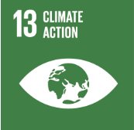
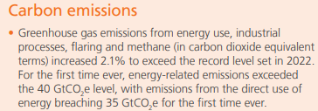
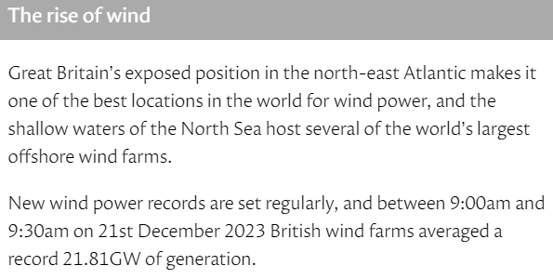
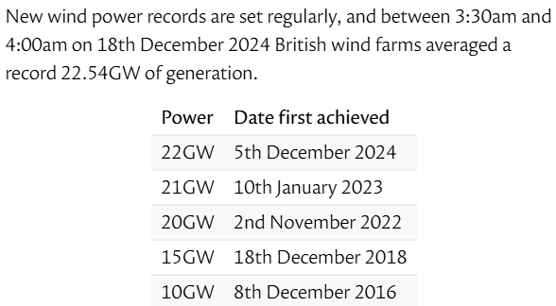
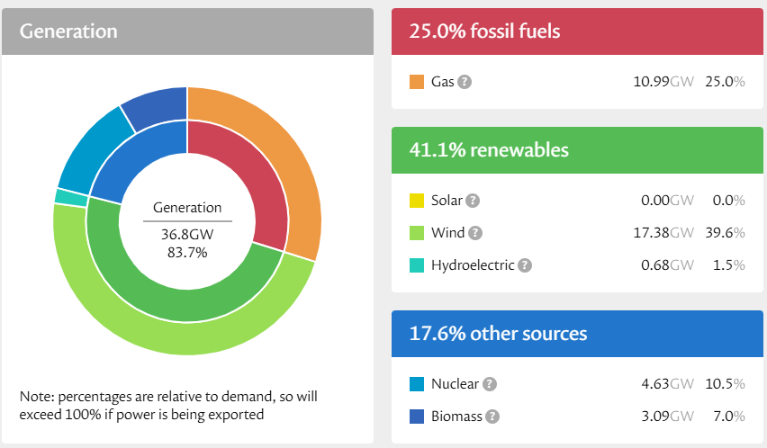
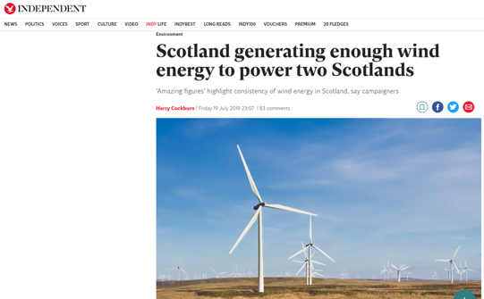
How is the energy mix changing?
Energy Institute Statistical Review of World Energy 2024
Yesterday's energy mix for electricity generation in the UK
https://grid.iamkate.com/

Slide 39


Two major issues remain
There remains lots of uncertainty about the impacts of climate change on ecosystems, communities, populations and processes;
  Environmental science research plays a key role in reducing this uncertainty
Solutions to climate change crisis are in their infancy;
  Environmental science research plays a key role in developing sustainable solutions

Slide 40
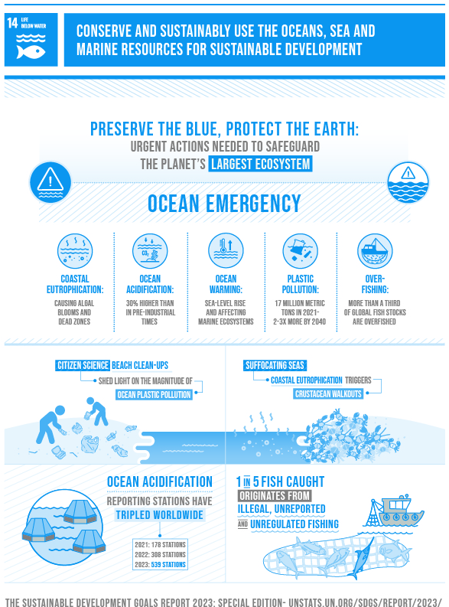

Key environmental science related challenges:
What is the link between fisheries production and climate change?
Meta-ecosystem concept: don’t consider marine as separate from land
We’re still finding new species
  Especially microbial life...
Stopping pollution – how to police the oceans
2024 status: Regression

Slide 41
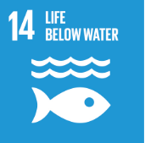
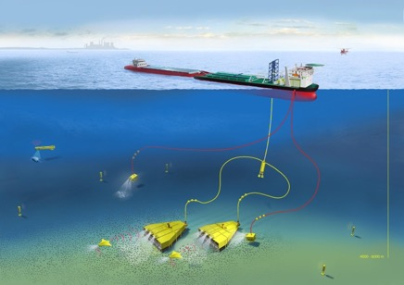
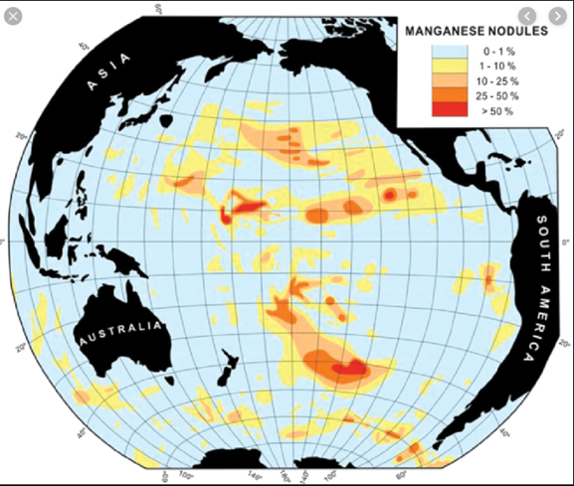
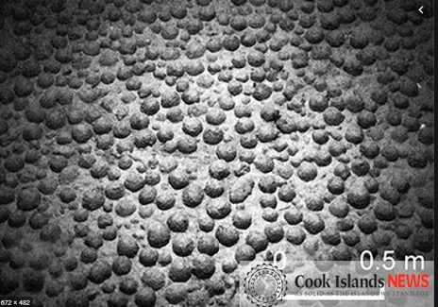

Seafloor mining of manganese nodules
Nickel, Copper, Cobalt, Lithium and Rare Earth Elements
Together with Antarctica, the deep-sea floor outside the continental shelf remains today the only large area on Earth which is not being used for the extraction of mineral resources of any kind.
However, what is the ecological impact?
Impact of oil spills e.g. Deep Water Horizon in 2010

Slide 42
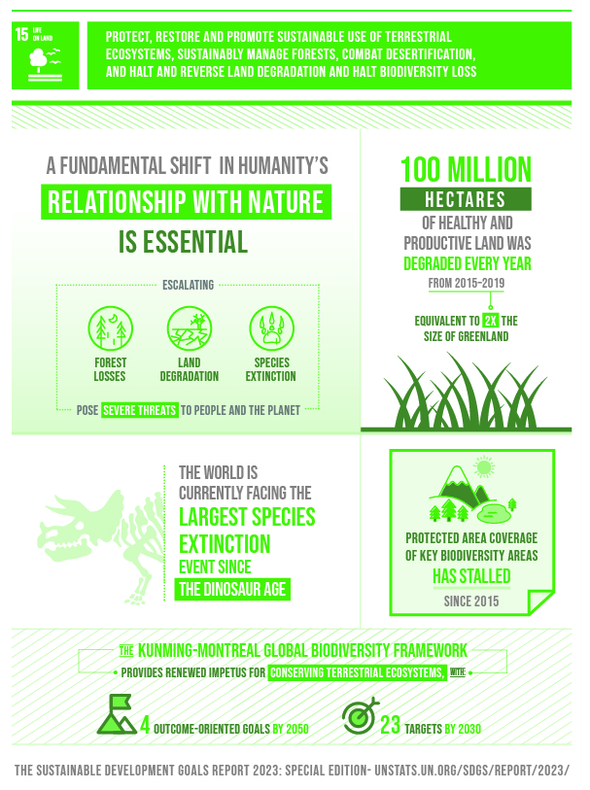
Key environmental science related challenges:
Just how important is biodiversity for ecosystem function?
Biodiversity = more than just species richness
‘Planting trees’ – it’s more complex than this
Remember the soil!
2024 status: Regression

Slide 43
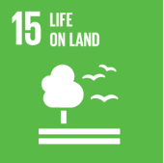
Life on land – key facts
Around 1.6 billion people depend on forests for their livelihood, including 70 million indigenous people.
Forests contain more than 80% of all terrestrial species.
Between 2010 and 2015, the world lost 3.3 million hectares of forest.
2.6 billion people depend directly on agriculture, but 52% of the land used for agriculture is moderately or severely affected by soil degradation.
Over 80% of the human diet is provided by plants. Only three cereal crops – rice, maize and wheat (all grasses) – provide 60% of energy intake.
Microorganisms and invertebrates, especially those in soil, are key to ecosystem services, but their contributions are still poorly known and rarely acknowledged

Slide 44

Forests: climate mitigators, reservoirs of biodiversity & critical resources
Planting trees is making the news and UK government policy: but will this provide a ‘silver bullet’ to solve big issues?

Slide 45
Biodiversity: is there a link to ‘ecosystem functioning’?
Does it matter if an ecosystem has more or less species in terms of how that ecosystem functions?

Slide 46



Slide 47
Many environmental challenges require knowledge of how soils function

Slide 48




Impacts of mining
Much can be resolved through legislation and land reclamation
Acid Mine Drainage (AMD)
Athabascan tar sands, Canada
Solid-phase Iron(III) oxides (ochre) in a water channel

Slide 49

We need to be mindful of how the SDGs interact…
This paper analysed SDG interactions in published “Integrated Assessment Models”
Interactions between ‘social’ and ‘natural’ science SDGs feature poorly in models

Slide 50





















Key example:

Slide 51
Key take home messages:
The world is facing an increasing number of challenges, especially in less-developed countries, and this has led to the creation of the Sustainable Development Goals;
Many of these challenges are relevant to all of society;
Environmental science underpins these challenges;
These issues are regulated by multiple interactive factors that cut across traditional discipline boundaries;
Environmental solutions need to reflect these attributes;
You are the next generation of problem solvers

Slide 53
 | w/c
1 | 27-Jan | Introduction to a Sustainable Planet | VC/SN
2 | 3-Feb | Soils, fertilizer minerals and water resources | VC
3 | 10-Feb | The food crisis and soil processes | SN
4 | 17-Feb | Iron and other key mineral resources for battery technology | VC
5 | 24-Feb | Biodiversity & Ecosystem Function | SN
6 | 3-Mar | Non-metals, industrial resources. Fossil Fuels | VC
7 | 10-Mar | CCUS (Tyne) | SN
8 | 17-Mar | Nuclear | VC
9 | 24-Mar | Emerging contaminants and wastewater treatment | SN
10 | 31-Mar | Environmental Pollution and Climate Change Relevant to the SDGs + EXAM technique | VC/SN
11 | 28-Apr | Summary/overview/future outlook | VC/SN

Slide 54


Slide 55
Publications – please get into the habit of reading peer-reviewed papers, “grey” literature, and relevant popular articles
Weekly magazines that include rigorous, high-impact peer reviewed articles (including research papers, perspectives, opinions, reviews) as well as editorial material
A plethora of journals devoted to broad and general disciplines
Don’t be put off, but be very selective!

Slide 56
Why and how and we would like you to use publications….
Good news! These things usually lead to high marks in exams and assessments!
Broaden your general knowledge of subject material
Provide ready means to “evidence” that knowledge (e.g. through citation, either direct or indirect)
Provide the means to critically evaluate questions and topics
Use to gain broad, general information
Do not get bogged down in methodological details of the work, but focus on key take-home messages
You will not be examined on specific publications
You will be examined on topics publications tackle

Slide 57

“Publication of the week”
https://doi.org/10.1038/s41586-019-1681-6

Slide 58

The abstract tells you a lot - sometimes enough!
Intro to whole paper and aims – gives you context
Main findings with some summary technical details
Key take home messages highlighting main challenge

Slide 59
What did this paper find?
It focused on ways in which humanity could USE CO₂, as opposed to reducing the emissions, as part of a climate mitigation strategy
The paper estimated the amount of CO₂ that could potentially be used from 10 broad technologies: (1) CO₂-based chemical products, including polymers; (2) CO₂-based fuels; (3) microalgae fuels and other microalgae products; (4) concrete building materials; (5) CO₂ enhanced oil recovery (CO₂-EOR); (6) bioenergy with carbon capture and storage (BECCS); (7) enhanced weathering; (8) forestry techniques, including afforestation/reforestation, forest management and wood products; (9) land management via soil carbon sequestration techniques; and (10) biochar.
Lots of uncertainty!
But certainly lots of potential e.g. forestry may remove 500-3600 MT of CO₂ per year in 2050...

Slide 60



Slide 61

Estimates of CO₂ removal potential….

Slide 62
Questions for you to discuss, here and now, with your neighbours
Should we bother with enhancing CO₂ utilisation, but instead focus all efforts on emission reduction?
Which technologies suggested strike you as being the most “sustainable”?

